Slide 1
How to Teach Computers to Process Natural Language S1: AI on Speech Recognition
Dr. Du Pengfei
SVS/DMD
21 Mar 2024

Slide 2
Agenda
Basic background knowledge briefing of NLP
Hands on through https://machinelearningforkids.co.uk/#!/about :
First round:
Speech Recognition: Project of Making a Smart Bulb on Scratch 3
Sentiments Analysis: Project of Making Me Happy on Scratch 3
2nd round: is to make chatbot and encourage students to implement more creative projects on top of those achievements.

Slide 3
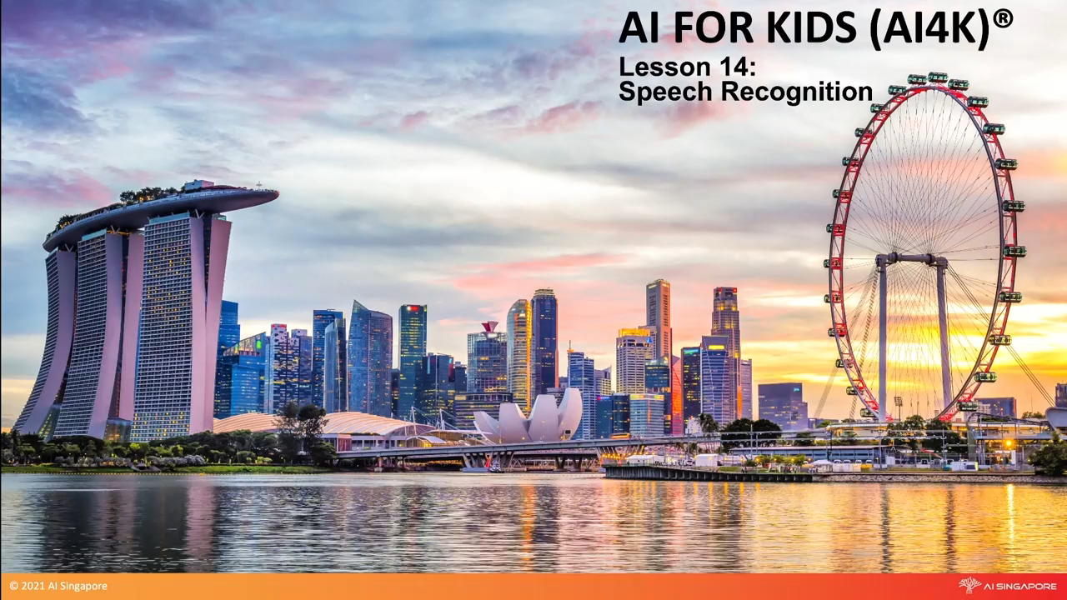
Speech Recognition

Slide 4
Recap
How Computers Recognize Objects?

Slide 5
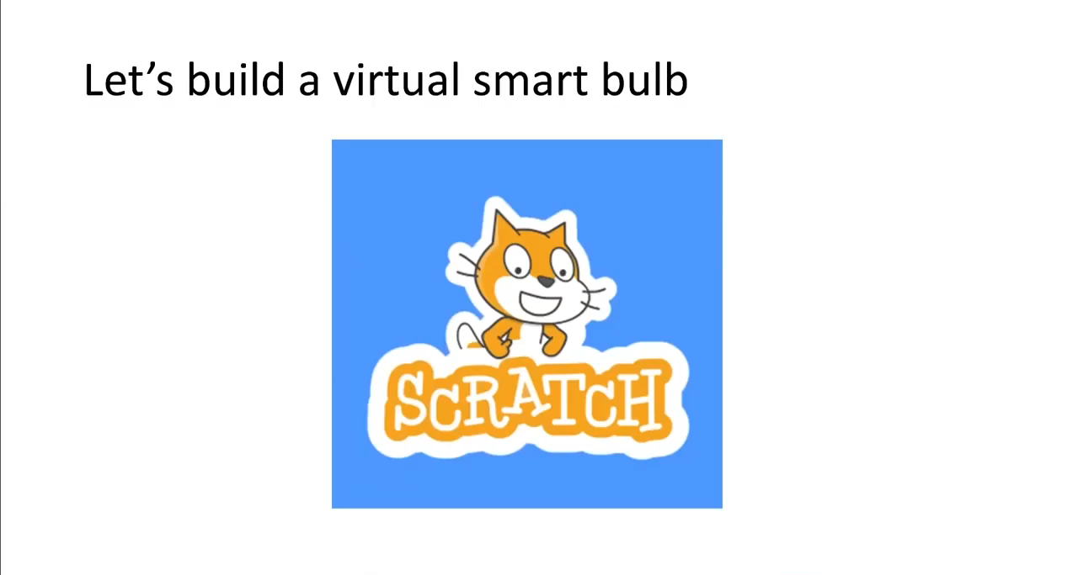
Hands on

Slide 6
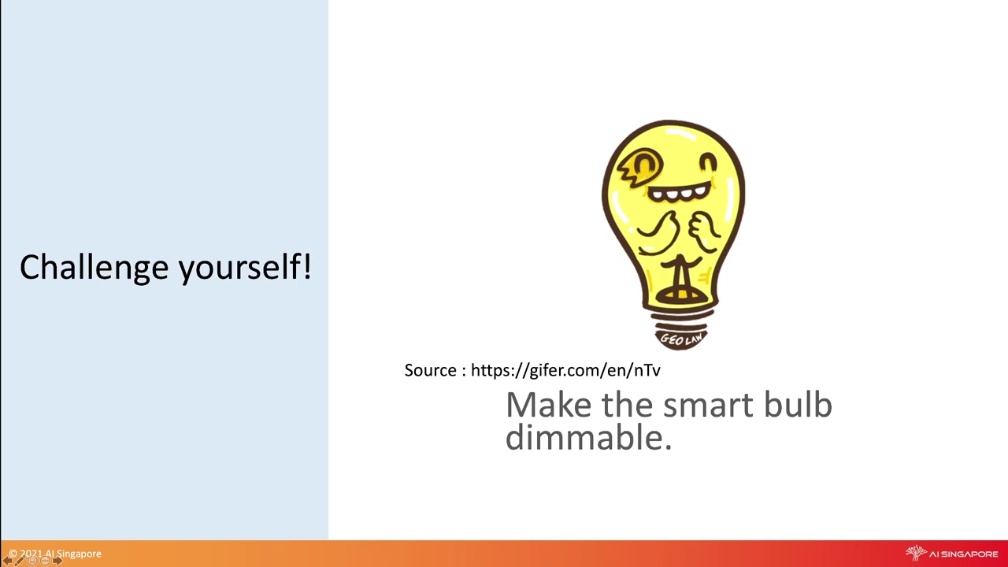
Extension: Meet our Student: AI computers
Notes:
https://www.youtube.com/watch?v=2hXG8v8p0KM

Slide 7

Summary

Slide 8
Contact: Du Pengfei
du_pengfei@SIMTech.a-star.edu.sg

